Slide 1

Security Measures: Data Encryption and Audits
| #X%2asdd | @X219xz$$ sdkfj1 | 2kdfh #5xkad | #X%2asdd | @X219xz$$ sdkfj1 | 2kdfh #5xkad | #X%2asdd |
June 6, 2024
| #X%2asdd | @X219xz$$ sdkfj1 | 2kdfh #5xkad | #X%2asdd | @X219xz$$ sdkfj1 | 2kdfh #5xkad | #X%2asdd |

Slide 2
Introduction to Security Measures
Understanding SSL/TLS Encryption
Steps to Implement SSL/TLS
Testing SSL/TLS Implementation
Secure Password Hashing with Bcrypt
Steps to Implement Bcrypt
Regular Security Audits
Implementation Steps for Security Audits
Agenda

Slide 3

Introduction to Security Measures
Data encryption ensures secure transmission of information between client and server, preventing interception by malicious actors.
Secure password hashing, such as using bcrypt, protects user data even if the database is compromised.
Regular security audits help identify and address vulnerabilities, maintaining the integrity and security of the application.

Slide 4

Understanding SSL/TLS Encryption
SSL (Secure Sockets Layer) and TLS (Transport Layer Security) are cryptographic protocols designed to provide secure communication over a computer network. SSL/TLS encryption ensures that any data transmitted between a client (such as a web browser) and a server is encrypted, making it unreadable to unauthorized parties. This prevents eavesdropping, tampering, and forgery of the transmitted data, thereby safeguarding sensitive information such as login credentials, personal data, and financial transactions.

Slide 5
Steps to Implement SSL/TLS
| #X%2asdd | @X219xz$$ sdkfj1 | 2kdfh #5xkad | #X%2asdd | @X219xz$$ sdkfj1 | 2kdfh #5xkad | #X%2asdd |
Obtain SSL/TLS Certificate
Purchase a certificate from a trusted Certificate Authority (CA) or use a free option like Let's Encrypt. Ensure the certificate covers all relevant subdomains (e.g., www, api).
Configure Web Server
For nginx: set proxy configurations to use the obtained certificate. Ensure the server is correctly set up to handle HTTPS traffic.
Enforce HTTPS
Redirect all HTTP traffic to HTTPS. Update the application configuration to use HTTPS URLs for API requests.
Secure Configuration
Disable older, less secure SSL/TLS versions. Enable HSTS (HTTP Strict Transport Security) to force browsers to only use HTTPS.
| #X%2asdd | @X219xz$$ sdkfj1 | 2kdfh #5xkad | #X%2asdd | @X219xz$$ sdkfj1 | 2kdfh #5xkad | #X%2asdd |

Slide 6

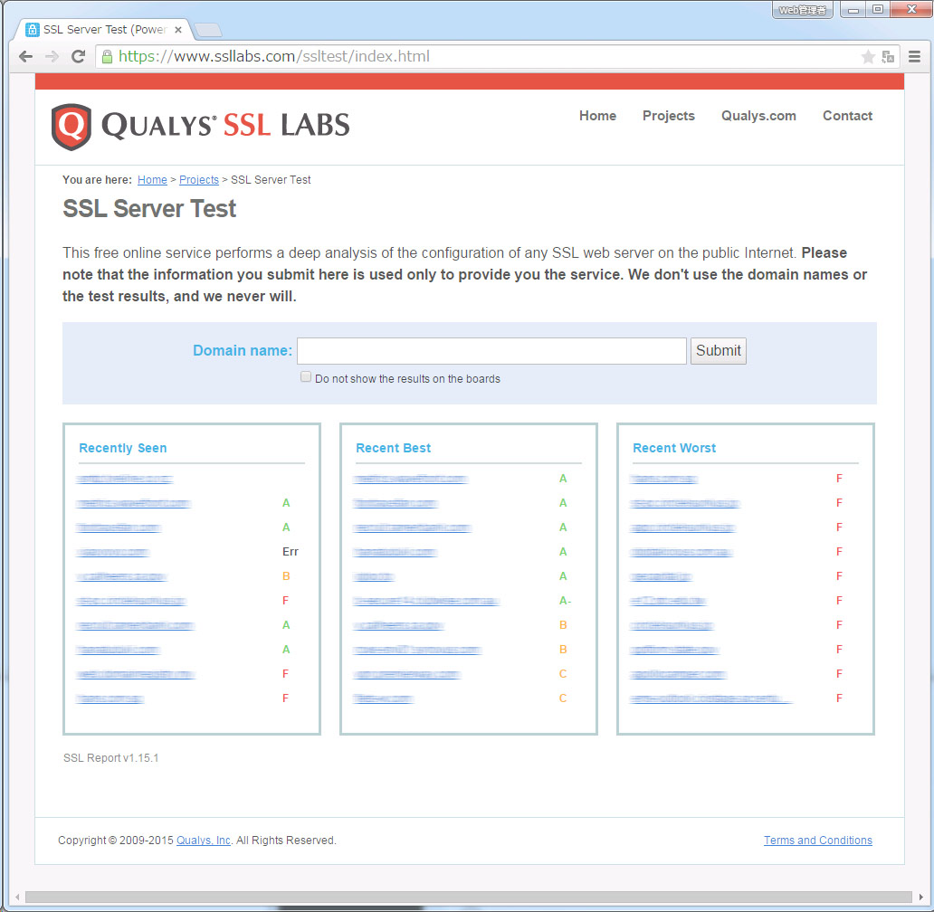
Testing SSL/TLS Implementation
Steps to Test SSL/TLS Implementation
Use Qualys SSL Labs: Navigate to the Qualys SSL Labs website and enter your domain to start the test.
Analyze Results: The tool provides a detailed report on your SSL/TLS configuration, including protocol support, key exchange, and cipher strength.
Identify Issues: Look for any warnings or low scores in the report. These indicate potential vulnerabilities or areas for improvement.
Implement Fixes: Adjust your SSL/TLS settings based on the recommendations provided by the tool. Re-test to ensure issues are resolved.

Slide 7

Secure Password Hashing with Bcrypt
| #X%2asdd | @X219xz$$ sdkfj1 | 2kdfh #5xkad | #X%2asdd | @X219xz$$ sdkfj1 | 2kdfh #5xkad | #X%2asdd |
Storing passwords securely is crucial to protect user data in case of a database breach. Bcrypt is a secure hashing algorithm designed for this purpose. It automatically handles salting and iterations, ensuring that each password hash is unique and resistant to common attacks such as rainbow table and brute-force attacks. By integrating bcrypt into your authentication system, you ensure that user passwords are stored in a way that significantly enhances security and mitigates the risk of unauthorized access.
| #X%2asdd | @X219xz$$ sdkfj1 | 2kdfh #5xkad | #X%2asdd | @X219xz$$ sdkfj1 | 2kdfh #5xkad | #X%2asdd |

Slide 8
Steps to Implement Bcrypt
Hash Passwords
Install Bcrypt
Update Registration
Salting & Iterations
Install the bcrypt library in your development environment.
Integrate bcrypt into your application to hash user passwords securely.
Ensure bcrypt is used during user registration and authentication processes.
Bcrypt automatically handles salting and iterations for added security.
Python: pip install bcrypt
Node.js: npm install bcrypt
Use bcrypt to hash passwords before storing them in the database
Use the set_password method for new users
Use the check_password method during login
Unique salt and iterations for each password

Slide 9
Regular Security Audits
Essential to identify and mitigate vulnerabilities in the application.
Should be performed quarterly and after significant changes or security incidents.
Utilize automated tools like Bandit, ESLint, Snyk, and OWASP ZAP for static code analysis, dependency scanning, and web vulnerability scanning.
Conduct manual penetration testing, focusing on critical areas like authentication, authorization, data storage, and transmission.
Review and update security policies and procedures regularly; train the development team on secure coding practices.

Slide 10
Implementation Steps for Security Audits
Establish a Schedule
Conduct security audits quarterly and after major releases. Perform additional audits after any security incident to identify and mitigate potential risks.
Use Automated Tools
Employ static code analysis tools like Bandit for Python or ESLint for JavaScript. Utilize dependency scanning tools like Snyk to check for vulnerabilities in third-party libraries.
Manual Penetration Testing
Hire security experts to perform penetration testing, focusing on critical areas such as authentication, authorization, data storage, and transmission. This helps uncover vulnerabilities that automated tools might miss.

Slide 11

THANK YOU
THANK YOU | THE END | THANK YOU | THE END | THANK YOU | THE END | THANK YOU | THE END | THANK YOU | THE END |
THE END | THANK YOU | THE END | THANK YOU | THE END | THANK YOU | THE END | THANK YOU | THE END | THANK YOU |

